Slide 1
Heart disease prediction
Group no 37
Using data science and data analysis
Presented by Gaurav Shripad

Slide 2
Content
Abstract
Important data visualization libraries in python
Understanding with graph
Data pre processing
Sorting by X and Y
Decision tree classifier
K Nearest Neighbor
Conclusion

Slide 3
Abstract
We are creating a Data Science and Analysis Project on Heart Disease Prediction. The project uses raw data in form of .csv and .xls files and transforms it into a Data Analysis. This project is attempt of data analysing on Heart Disease Prediction with the help of Data Science and Data Analysis in python code. This analysis will help us to find the basis behind common notions about the disease prediction found between which age from purely a dataset perspective.

Slide 4
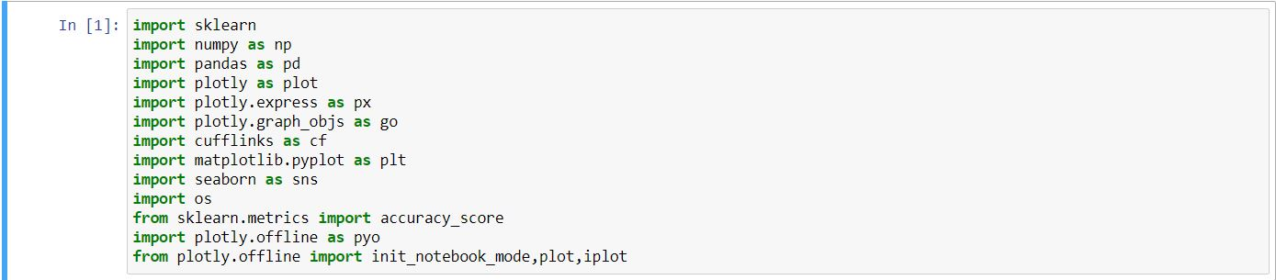
Important data visualization libraries in python
Libraries used
sklearn,numpy,pandas,plotly,plotly express,plotly graph objs,cufflinks,matplotlib,seaborn,sklearn metrics

Slide 5
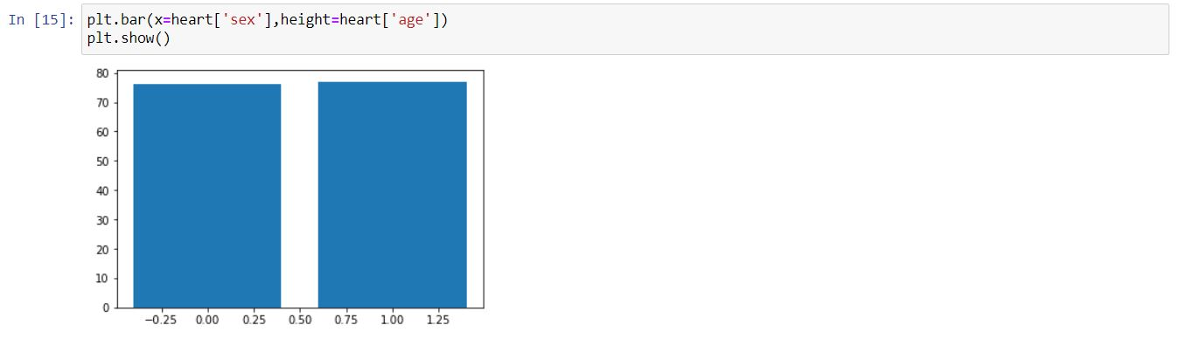
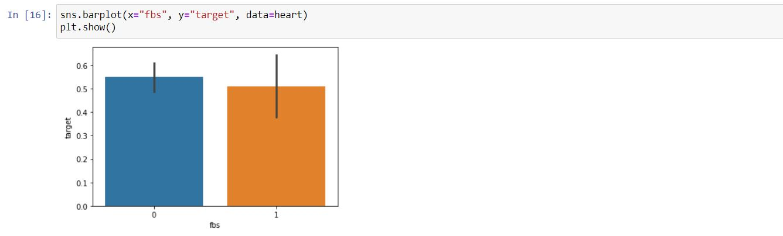
Understanding with Graph

Slide 6
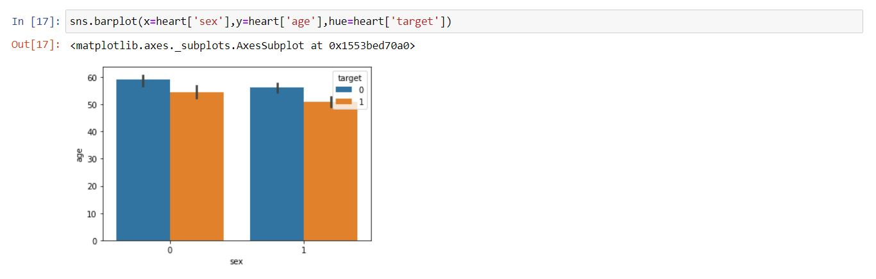
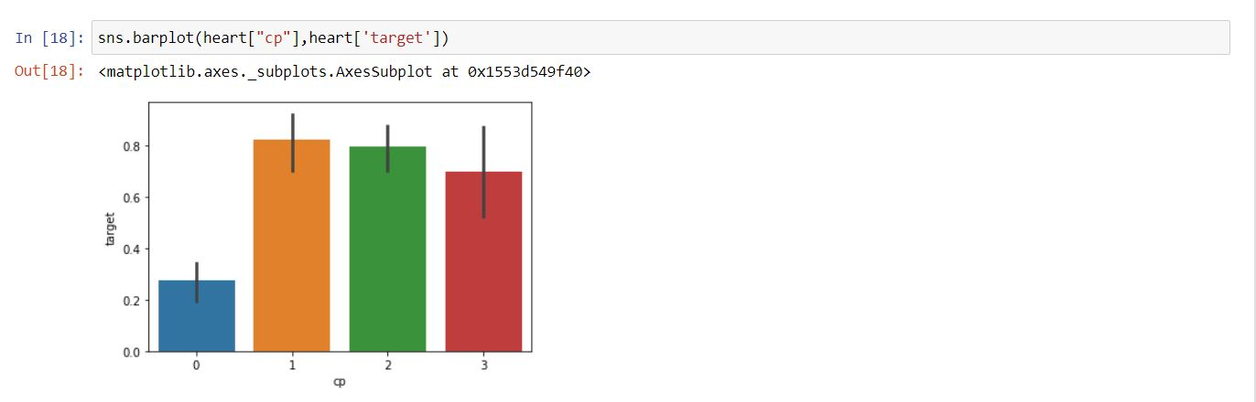

Slide 7
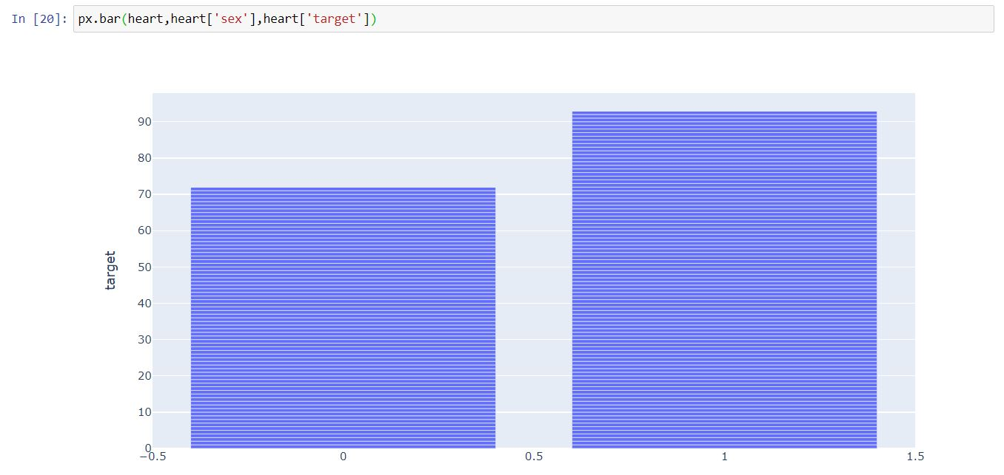
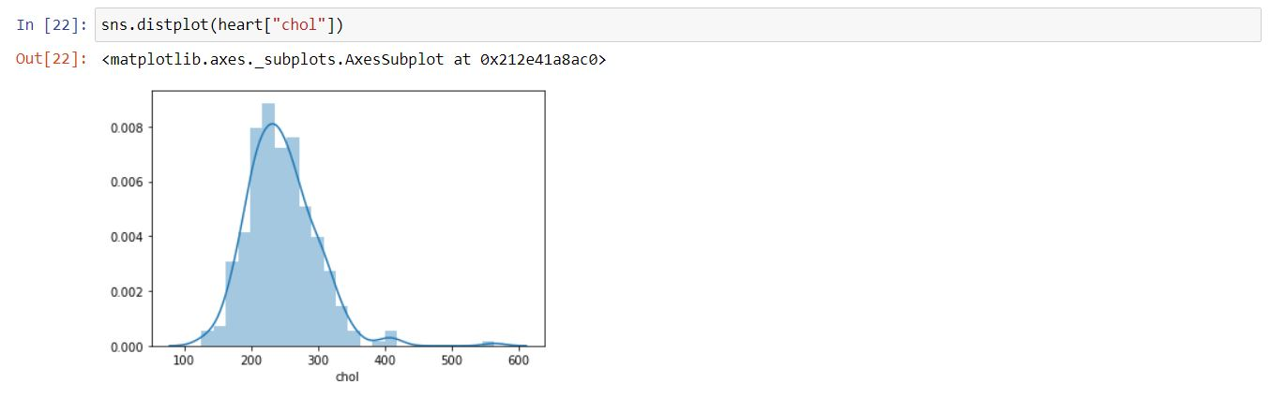

Slide 8
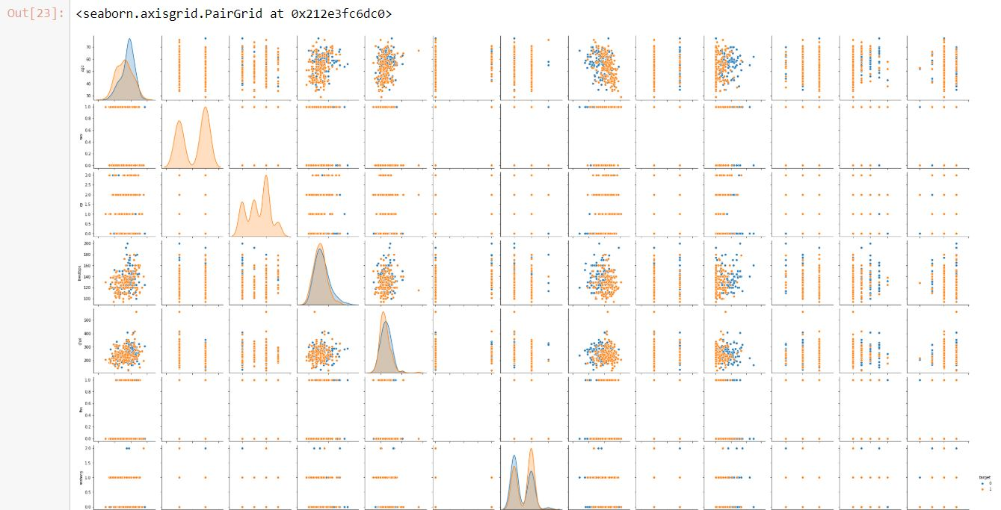
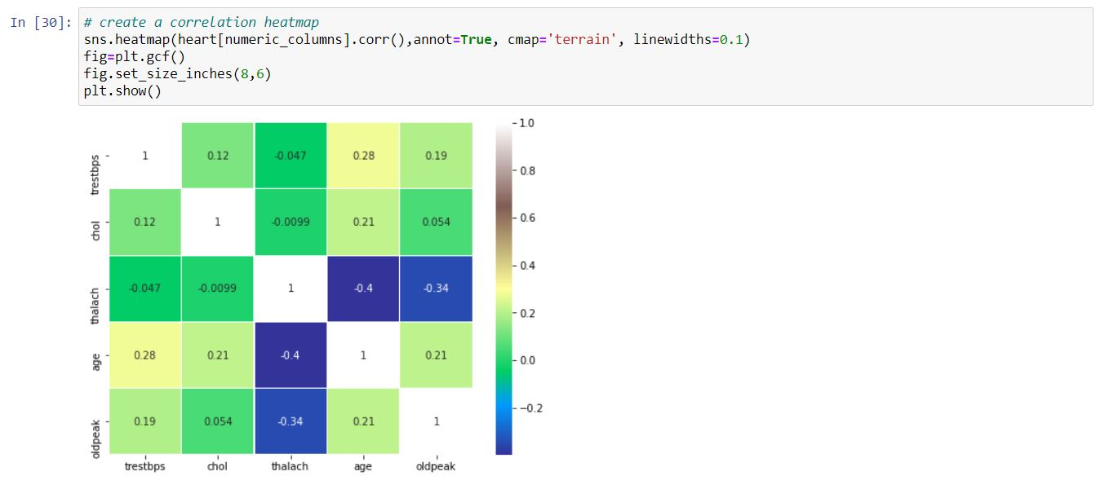

Slide 9
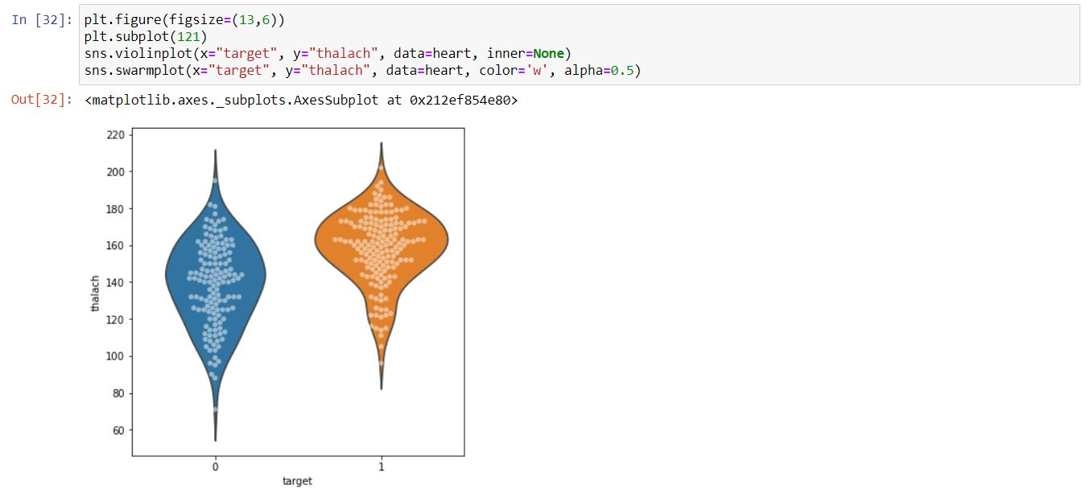
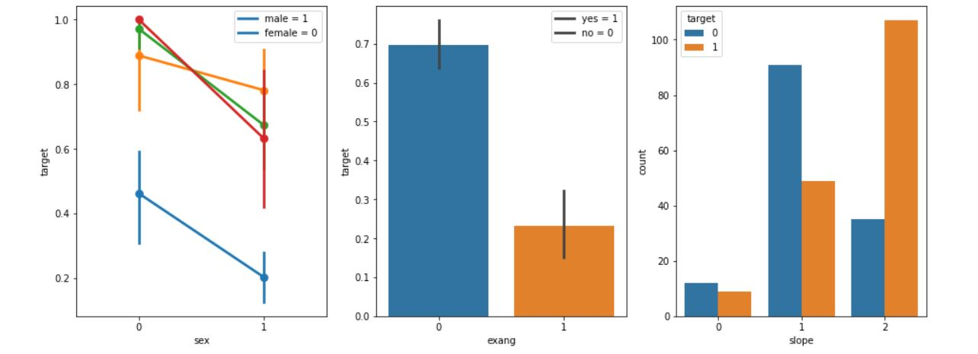

Slide 10
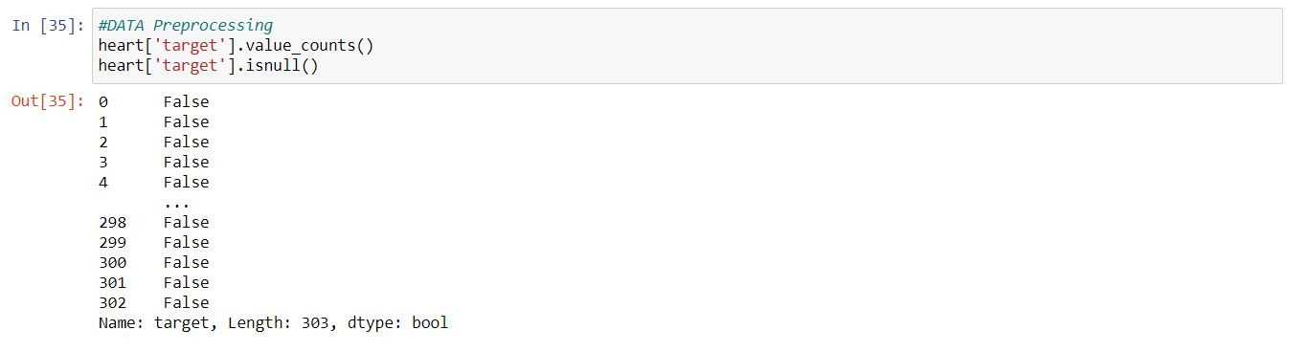
Data pre processing

Slide 11
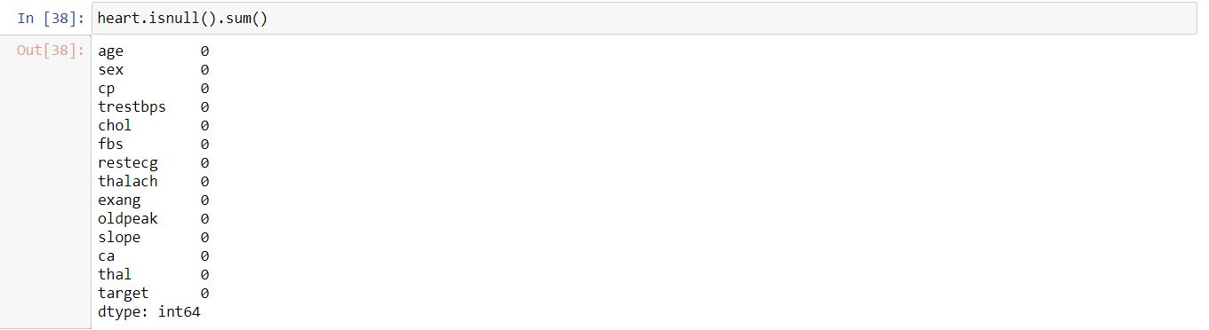
For further process it is pre processing is done

Slide 12
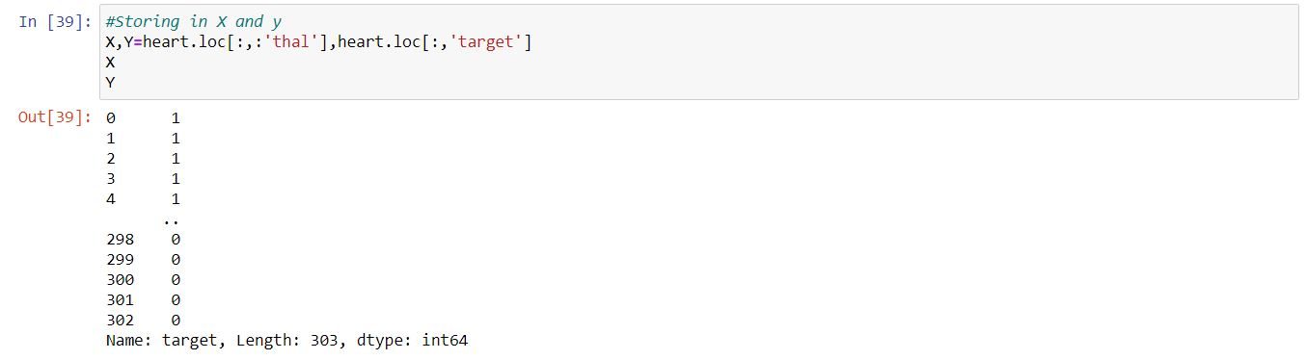
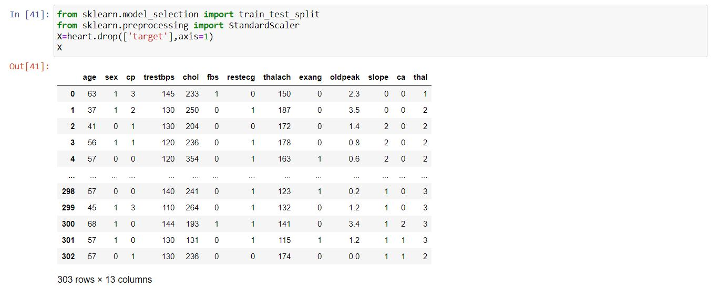
Sorting by X and Y

Slide 13
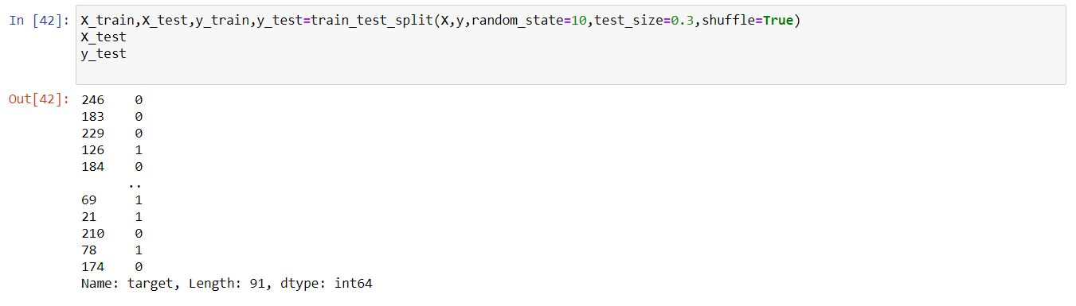
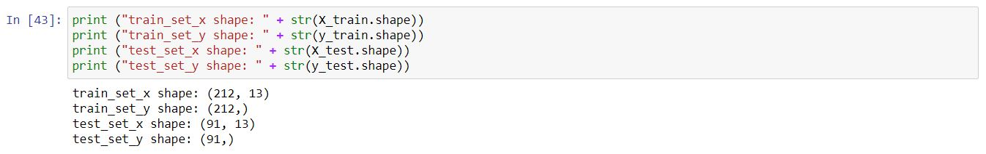

Slide 14
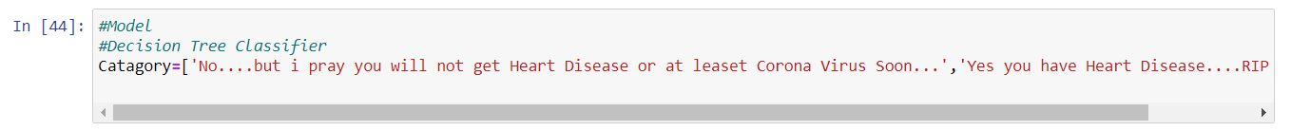
Decision Tree Classifier
A decision tree is a flowchart-like tree structure where an internal node represents feature(or attribute), the branch represents a decision rule, and each leaf node represents the outcome. The topmost node in a decision tree is known as the root node. It learns to partition on the basis of the attribute value.

Slide 15
K Nearest Neighbor
K-Nearest Neighbours, or KNN for short, is one of the simplest machine learning algorithms and is used in a wide array of institutions. KNN is a non-parametric, lazy learning algorithm. When we say a technique is non-parametric, it means that it does not make any assumptions about the underlying data. In other words, it makes its selection based off of the proximity to other data points regardless of what feature the numerical values represent.

Slide 16
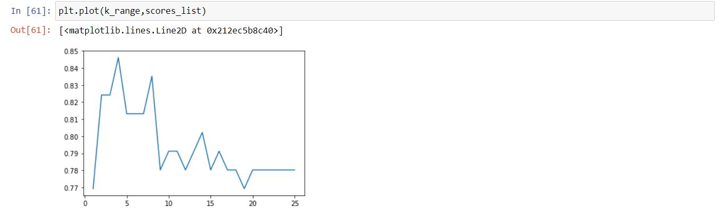

Slide 17
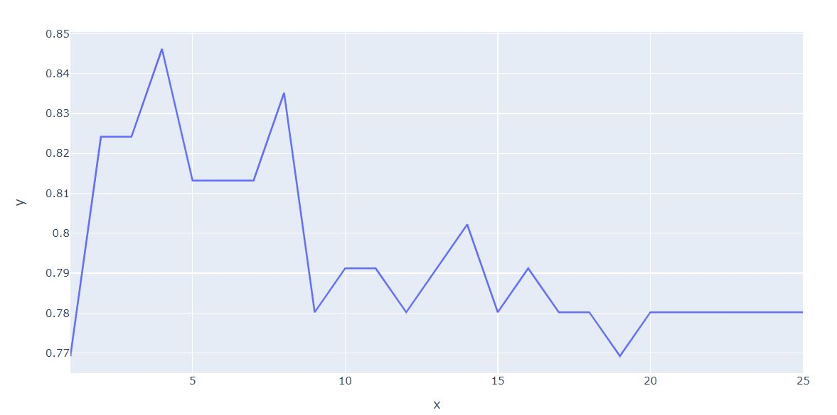

Slide 18
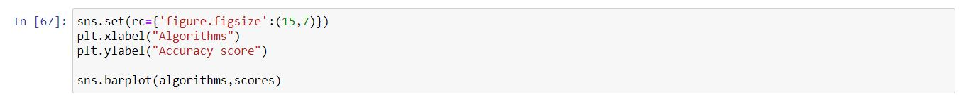
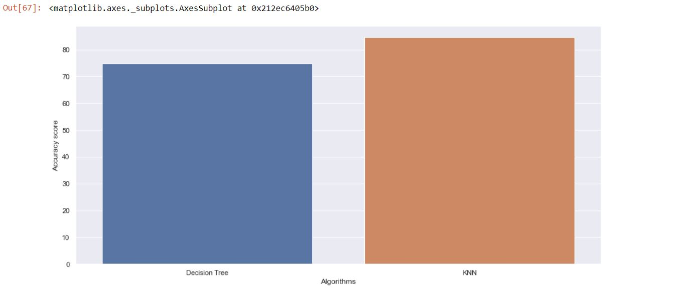
comparison between decision tree classifier and KNN

Slide 19
Conclusion
We analyse the data set by performing the datasets shape, size, sum, info to figure out its description.
We perform various graphs such as histogram, bar graph, bar plot, plotly express bar graph, distplot, pair plot, heatmaps, violinplot, swarmplot, and pair plot.
We process the data acquired from the target and sum, unique, isnull sum for its description and sort the entire data in x and y.
We use the data acquired to us it for train and test to find the predictions and accuracy.
We use the data for performing the decision tree classifier and k nearest neighbour.
We used all the acquired data and perform the comparison between decision tree and k nearest neighbour.
From all the analysis, we can understand that there are many people who are infected with heart disease because of due to some or the other problems such as bad cholesterol, chest pain etc.

Slide 20
Thank You

